Slide 1
UGA Proposal for Domestic Partner Benefits:
Frequently Asked Questions
GLOBES / Human Resources Committee of University Council
Report to University Council
September, 2012

Slide 2
1. Haven’t we tried this before?
Answer: Yes and No
Yes: We’ve tried (multiple times) to get full domestic partner benefits
No: We haven’t tried the current proposed strategy

Slide 3
2. What have we done before?
Answer: Asked the Board of Regents (multiple times) to add domestic partners as beneficiaries to our health insurance policy
When? In 2002, 2005, 2007, 2012
Result? No action taken

Slide 4
3. What’s different this time?
Answer: this proposal asks for two things. First, UGA will provide a domestic partner benefits package* with its own funds
Specifically: using discretionary funds…
  NOT state funds
  NOT tuition
  NOT student fees
*either actual health insurance benefits, or if this is not possible, a cash allowance to be used towards purchase of private insurance (equal to state spousal contribution)

Slide 5
3. What’s different this time (part 2)
Second, UGA will allow domestic partners to participate in optional /voluntary benefits programs, such as:
  Dental
  Optional life insurance
  Accidental Death & Dismemberment
These programs are already ENTIRELY funded by employee contributions (no state funds)
This is already happening at Georgia State, Georgia Tech, Kennesaw, Georgia Perimeter College, and Georgia Health Sciences University (MCG)

Slide 6
4. But won’t this still require approval of the Board of Regents?
Answer: No
If it’s not possible for UGA to provide actual health insurance for domestic partners, then…
Proposal is for UGA to provide a financial benefit equivalent to the state contribution to spousal health insurance coverage for married employees
UGA will pay for this locally, using no state funds and no student-related funds

Slide 7
5. Who would be eligible?
Answer: registered Domestic Partners
UGA has a formal application process (since 2005).
Only domestic partners who are not participating in another employer-sponsored health insurance plan will be eligible

Slide 8

Domestic Partner Registration

Slide 9
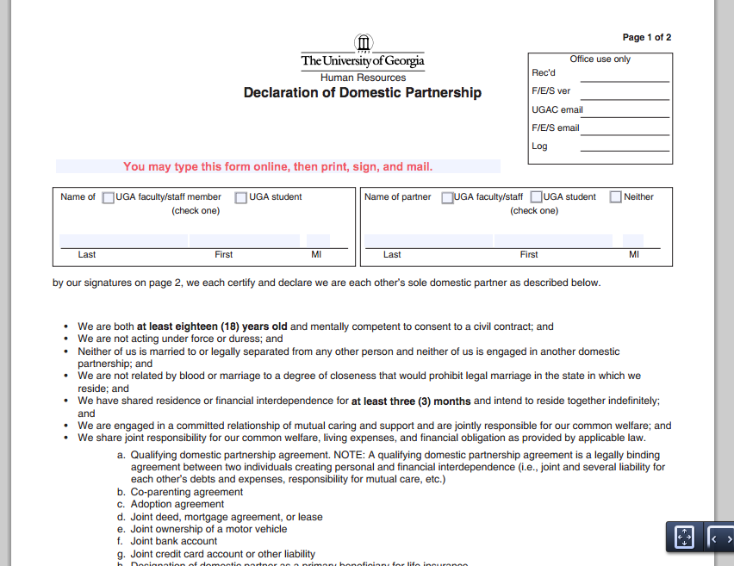
Domestic Partner Registration

Slide 10
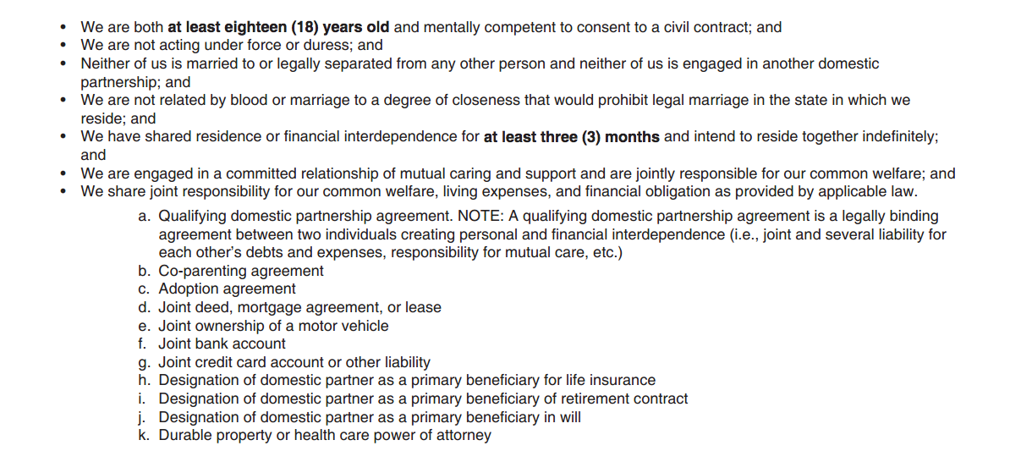
Criteria for Domestic Partners are well-established and non-trivial

Slide 11
6. What would it cost?
Answer: it depends on how it’s implemented
We are estimating $450 / month per participant
This is how much the state contributes to the health insurance premium of a spouse of a UGA employee

Slide 12
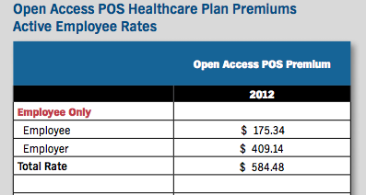
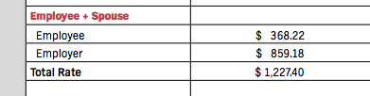
State contribution to insurance
State contribution to single employee: $409
State contribution to married employee + spouse: $859
$859 - $409 = $450 (how much more the state contributes to health insurance for (employee + spouse) vs. employee alone

Slide 13
7. How many people will participate?
Answer: Unknown
We asked other similar public state universities about the level of participation in their domestic partner benefits program
Most common answer: less than 1% of benefits-eligible employees

Slide 14
Participation at other institutions
Institution | Employees | Domestic Partners | % of participation
U of Wyoming | 3000 | 33 | 1%
U of Florida | 14000 | 63 | .45%
U of Arizona | 11000 | 56 | .5%
Penn State | 18000 | 40 | .2%
U of Minnesota | 18000 | 188 | 1%

Slide 15
Cost at UGA based on these data?
$450 / month per participant
$5400 / year
UGA has approx 10,000 benefits-eligible employees
10,000 times .005 = 50 estimated participants
50 times $5400 = estimated annual cost of $270,000

Slide 16
8. Why does it matter?
Answer: Institutional Reputation
U.S. News and World Report’s Top 50 universities:
87% offer full domestic partner benefits
UGA peer institutions: 75% offer full DP benefits
UGA aspirational institutions: 75% offer full DP benefits
There is a real cost of not having these benefits
It’s not expensive, we can do it locally, and it’s the right thing to do

